Slide 1
LIFE OPERATING System (l os)
ife

Slide 2
Presented By,
URMI KARMAKAR 22-47163-1
TAHNIA TUHIN TISHA 21-44891-2
NUSHRAT JAHAN 22-46149-1

Slide 3

What is a Use Case Diagram?
A use case diagram is a graphical representation of a system's functionalities or capabilities from the perspective of its external users or actors. It's one of the Unified Modeling Language (UML) diagrams commonly used in software engineering to describe and visualize the interactions between users (actors) and a system. Use case diagrams help to capture the requirements of a system and provide a high-level view of its behavior without delving into internal implementation details.

Slide 4
Benefits of use case diagram :
Use cases are the primary vehicle for system requirements
Use cases are described using the language of the customer
(language of the domain which is defined in the glossary)
Use cases provide an easily-understood communication
mechanism
When requirements are traced, they make it difficult for
requirements to fall through the cracks
Use cases provide a concise summary of what the system
should do at an abstract (low modification cost) level.

Slide 5
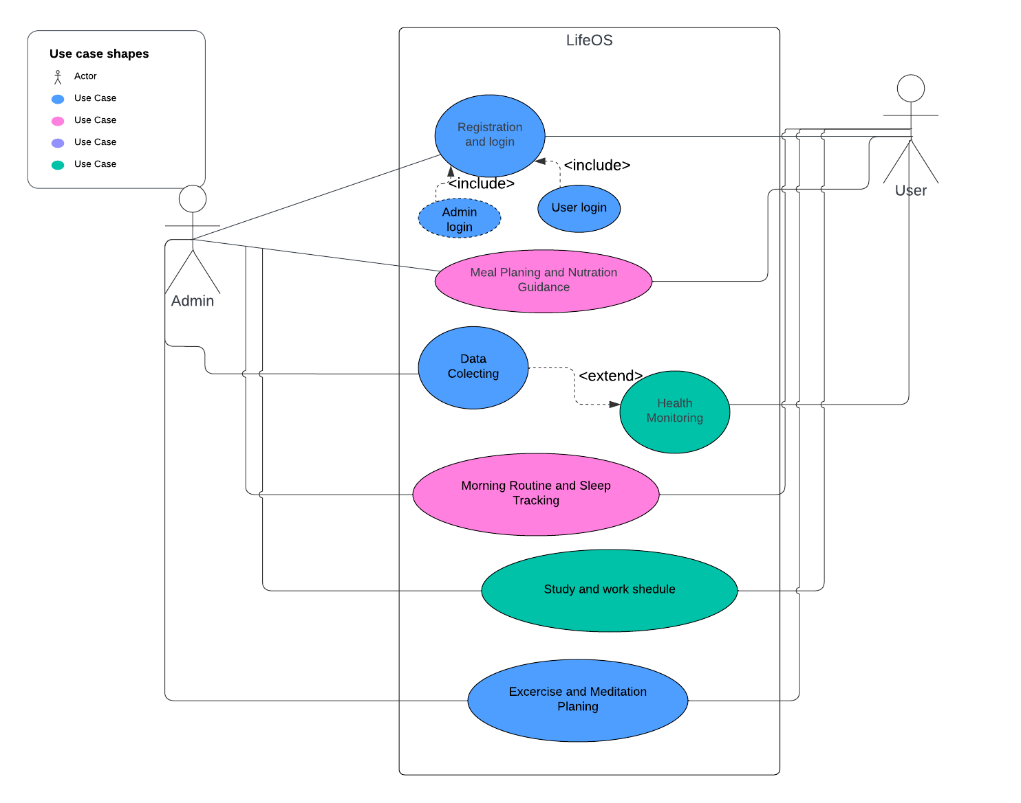
use case diagram

Slide 6
THANK YOU everyone

